Slide 1
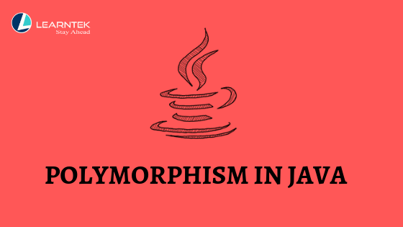

Slide 2
Polymorphism is derived from 2 Greek words: poly and morphs.
The word “poly” means many and “morphs” means forms.
So Polymorphism means the ability to take many forms. is a concept by which we can perform a single task in different ways.
It is one of the most striking features of Object Oriented Programming in Java.

Slide 3
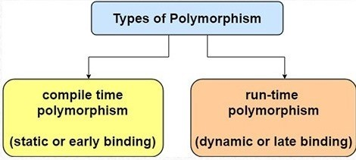
There are two types of polymorphism in Java:
1) Compile-time polymorphism (static binding)
2) Runtime polymorphism (dynamic binding)
Method overloading is an example of compile time polymorphism, while method overriding is an example of runtime polymorphism.

Slide 4
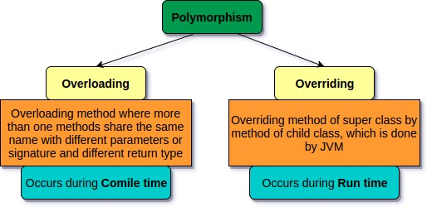

Slide 5
Method Overloading:
If a class has multiple methods having same name but different in parameters, it is known as Method Overloading.
Method overloading is performed within class.
If we must perform only one operation, having same name of the methods increases the readability of the program.
There are three ways to overload the method in java
• By changing number of arguments
• By changing the data type
• By changing both number of arguments and data type

Slide 6
a. Method overloading by changing number of argument:
class Addition
{
static int add1 (int a,int b)
{
return a+b;
}
static int add1(int a,int b,int c)
{
return a+b+c;
}
}
class xyz
{
public static void main(String[] args)
{
System.out.println(Addition.add1(13,13));
System.out.println(Addition.add1(9,9,9));
}
}
Output:
26
27

Slide 7
b. Method Overloading by changing the data type:
class Addition
{
static int add1 (int a,int b)
{
return a+b;
}
static double add1(double a,double b)
{
return a+b;
}
}
class xyz1
{
public static void main(String[] args)
{
System.out.println(Addition.add1(13,13));
System.out.println(Addition.add1(9.5,9.5));
}
}Output:
26
19

Slide 8
c. Method Overloading by changing both number of argument and data type:
class Overload1
{
void do (int a)
{
System.out.println (“a: ” + a);
}
void do (int a, int b)
{
System.out.println (“a and b: ” + a + “,” + b);
}
double do(double a)
{
System.out.println(“double a: ” + a);
return a*a;
}
}
class Overload2{
public static void main (String args [])
{
Overload1 Obj = new Overload1();
double result;
Obj.do(20);
Obj.do(20, 30);
result = Obj.do(4.5);
System.out.println(“Output is: ” + result);
}
}a: 20
a and b: 20,30
double a: 4.5
Output is: 20.25

Slide 9
2. Run-time Polymorphism :
The type of polymorphism which is implemented dynamically when a program being executed is called as run-time polymorphism.
The run-time polymorphism is also called dynamic polymorphism or late binding.
Method Overriding in Java
Method overriding is used to achieve the runtime polymorphism or dynamic binding.
In method overriding the method must have the same name as in the parent class and it must have the same parameter as in the parent class.
If subclass (child class) has the same method as declared in the parent class, it is known as method overriding in Java.
Method overriding occurs in two classes that have IS-A (inheritance) relationship.

Slide 10
//parent class
class Animal
{
//define method
void do()
{
System.out.println(“Animal is eating food”);
}
}
//Create child class
class dog extends Animal
{
//define the same method as in the parent class
void do()
{
System.out.println(“Dog is eating food “);
}
Class Poly
{
public static void main(String args[])
{
dog obj = new dog();//creating object
obj.do();//calling method
}
}Output:
Dog is eating food

Slide 11
Advantage of polymorphism:
• It helps programmers to reuse the code, classes, methods written once, tested and implemented. They may be reused in many ways.
• Polymorphism helps in reducing the coupling between different functionalities.
• Method overloading can be implemented on constructors allowing different ways to initialize objects of a class. This enables you to define multiple constructors for handling different types of initializations.
• Method overriding works together with inheritance to enable code reuse of existing classes without the need for re-compilation.

Slide 12
Disadvantage of polymorphism:
• One of the main disadvantages of polymorphism is that developers find it difficult to implement polymorphism in codes.
• Run time polymorphism can lead to the performance issue where machine needs to decide which method or variable to invoke so it basically degrades the performances as decisions are taken at run time.
• Polymorphism reduces the readability of the program. One needs to identify the runtime behavior of the program to identify actual execution time.

